Slide 1

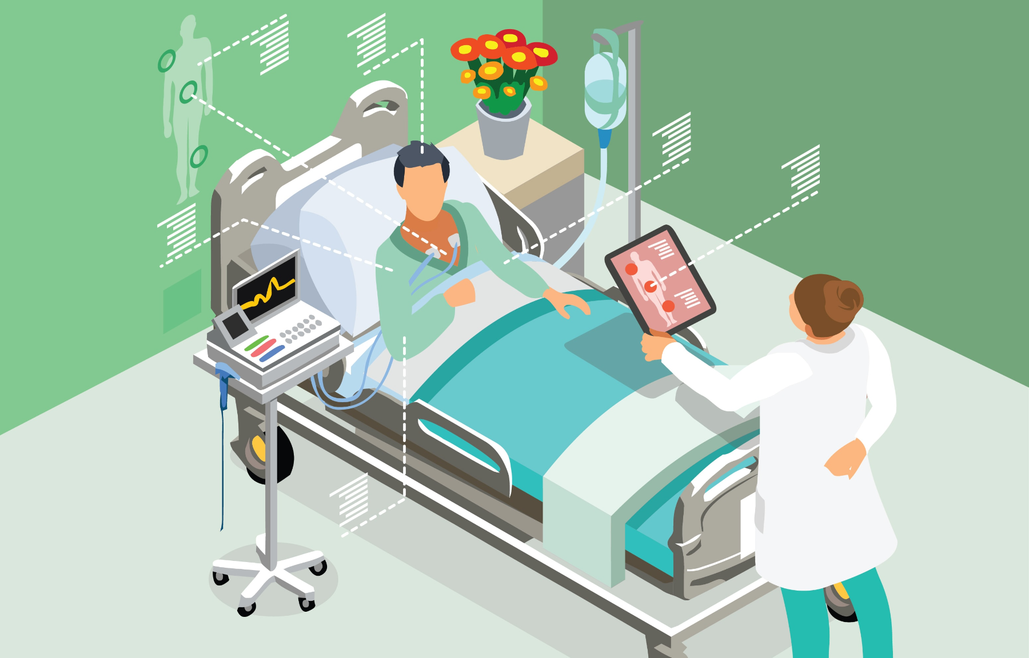
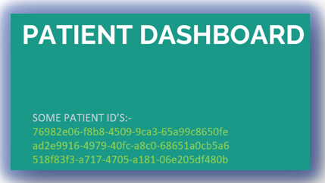

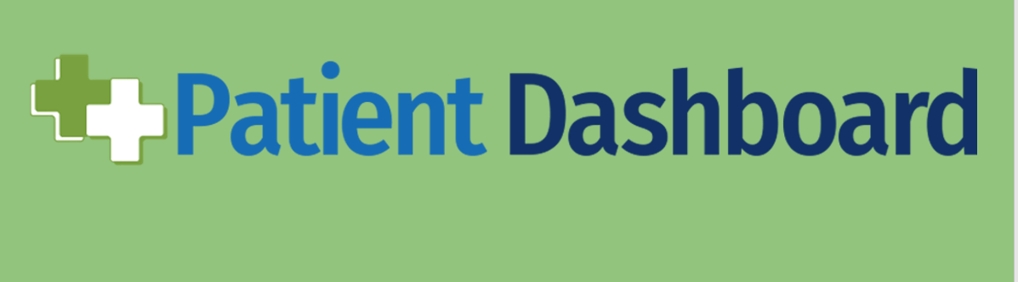
PATIENT DASHBORAD
Project Group ID:- 100
BHARTI GATTANI, NIMISH SARATHE, ABHISHEK THAPLIYAL,
UTKARSH KUMAR, NIKHIL KUMAR DAS
GUIDE:- Dr. VIKAS PANTHI
ABSTRACT
INTRODUCTION
OBJECTIVE
RESULLT
As we know that heatlh is one of the most important and largest sector in todays world. As the world is facing a pandemic the need of advancement in health sector is a much needed development. Now the world is shifting to a digital world and so is the health and medical sector. In digitalizing the health and medical sector web development is playing an important role. With the help of internet the health and medical field is becoming more and more accessible to the world.
The Patient Dashboard is the first screen that displays when you access a patient’s record and is a great tool for creating a single location for displaying data you view on a regular basis.
If you are a first-time Clinical Connect user, the Dashboard will be empty. You will need to populate the dashboard with clinical modules according to your clinical needs. Drag and drop the module icons found in the Patient Dashboard Header to add modules to your dashboard. The Patient Dashboard can also be accessed at any time by clicking the Dashboard: Patient option from the Clinical Modules menu.
The objective for the project is that many people in the world cannot easily access medical facilities majorly due to large distance from the hospitals.
This acts as a hinderance in their improvement and regular visiting of nurse is not a feasible solution. To resolve this issue we can use IoT enabled monitoring implants which can log the patient vital changes in the remote database server of the hospital.
First we open this patient dashboard. We enter the patient id (For example, 76982e06-f8b8-4509-9ca3-65a99c8650fe) , then a patient details will be displayed .
1- The dashboard successfully displays the details of the patient (Patient details like name, address etc.) (Patient Vital Observations) (Patient allergies) (Patient Conditions & Careplan) (Patient implants(if any)) (Medical Records(if any)) 2-The Dashboard also shows locations of various medical stores in the area on a map.
MODULES AND METHODS
CONCLUSIONS
This project is completely built on Python programming language and some of its libraries like numpy, panda and streamlit. The project takes a patient id as references and tallies it across all the datasets and gets the data matching to particular id and then organize the data across various categories and make it available on the finger tips of caretaker.
MySQL is an open source relational database management system.
Stream lit is an open-source python library for creating and sharing web apps for data science and machine learning projects.
Pandas is a Python package providing fast, flexible, and expressive data structures designed to make working with “relational” or “labeled” data both easy and intuitive.
NumPy can be used to perform a wide variety of mathematical operations on arrays.
This patient dashboard can be a very useful tool for patients . It will save a lot of time and space of patients as it can be accessed anytime from anywhere in the world. We are still working on this project and trying to add more and more features to this dashboard.
REFERENCES
https://patient-dashboard-streamlit.herokuapp.com/
https://www.udemy.com/course/the-complete-guide-to-angular-2/
https://getbootstrap.com/docs/5.1/getting-
https://www.geeksforgeeks.org/web-development
https://rapidapi.com/hub
https://www.boldbi.com/dashboard-examples/healthcare/patient-monitoring-dashboard

